Slide 1

Credit risk RWA and capital requirement for the bank’s residential mortgages portfolio
Standardized vs. F-IRB approach
Wroclaw, 15/03/2024

Slide 2
The standardized approach - overview
The standardized approach assigns standardized risk weights to exposures as described in chapter CRE20 to CRE22 of Basel Framework.
Risk weighted assets are calculated as the product of the standardized risk weights (based on exposure classification) and the exposure amount.
To apply correct risk weights under standardized approach we need to identify class of exposures, LTV ratio and whether the exposure is defaulted.
According to CRE 20.104 For risk-weighting purposes under the standardized approach, a defaulted exposure is defined as one that is past due for more than 90 days, or is an exposure to a defaulted borrower.

Slide 3
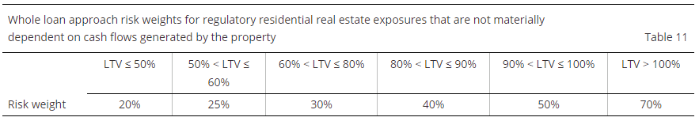
The standardized approach – risk weights
For not in default regulatory residential real estate exposures that are not materially dependent on cash flow generated by the property, the risk weight is assigned to the total exposure amount, based on the exposure’s LTV ratio as described in the tabele below.
Defaulted residential real estate exposures where repayments do not materially depend on cash flows generated by the property securing the loan shall be risk-weighted net of specific provisions and partial write-offs at 100%.

Slide 4
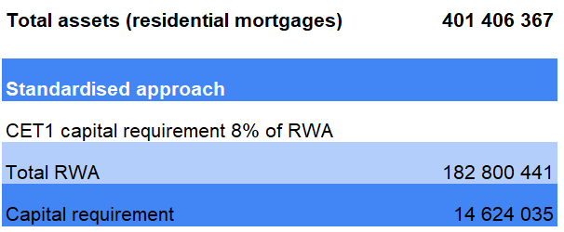
The standardized approach – RWA and Capital requirement

Slide 5
F-IRB approach - overview
Subject to certain minimum conditions and disclosure requirements, banks that have received supervisory approval to use the IRB approach may rely on their own internal estimates of risk components in determining the capital requirement for a given exposure.
The risk components include measures of the probability of default (PD), loss given default (LGD), the exposure at default (EAD), and effective maturity (M).
There two broad approaches: a foundation and an advanced approach:
Under the foundation approach (F-IRB approach), as a general rule, banks provide their own estimates of PD and rely on supervisory estimates for other risk components.
Under the advanced approach (A-IRB approach), banks provide their own estimates of PD, LGD and EAD, and their own calculation of M, subject to meeting minimum standards.
For both the foundation and advanced approaches, banks must always use the risk-weight functions provided in the Framework for the purpose of deriving capital requirements.

Slide 6
F-IRB approach – risk parameters
According to CRE 30.42 For retail exposures, banks must provide their own estimates of PD, LGD and EAD. There is no foundation approach for this asset class.
Residential mortgage which is an exposure to an individual should be categories as a retail exposure.
PD (Probability of Default) is a probability that a borrower will default in a particular time horizon, which is generally 1 year.
EAD (Exposure at Default) represents amount of loss that a bank may incur due to a default (amount outstanding to be paid).
LGD (Loss Given Default) represents a fractional loss in case of a default - amount that a bank will lose even after selling collateral (in other words: 1 minus recovery rate) LGD = (EAD - Collateral)/EAD.

Slide 7
F-IRB approach – risk paramenters - PD
Under IRB approach bank can determine own estimation of PD (Probability of Default). Each exposure has own PD.
Default probabilities are estimated using credit scoring or logistic regression on bank's interal data.
The models use quantitive and qualitive attributes connected with financial stability, debt payment capacity and willingness of a borrower. Commonly used attributes in scope of individual borrowers may include:
income level and stability of employment
DTI (debt-to income ratio)
LTV (loan-to-value ratio)
payment history
credit utilization (percentage of available credit a borrower is currently using)
length of credit history
type of loan (unsecured loans generally pose higher risk)
geographic location
loan purpose
age and demographic (employment status, material status).

Slide 8
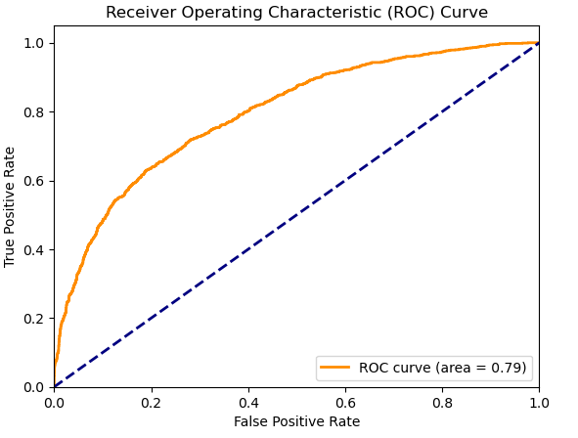
F-IRB approach – PD logistic regression
For this calculation PD was estimated using logistic regression.
The model was trained on avalilable parameters, which included:
Amount due on existing mortgage
Value of current property (collateral)
Occupation category
Years at present job
Number of major derogatory reports
Number of delinquent credit lines
Age of oldest credit line in months
Number of recent credit inquiries
Number of credit lines
Debt-to-income ratio (DTI)
Loant-to-value ratio (LTV)
The trained model has accurracy of 82,6% and AUC ROC score of 0,79

Slide 9
F-IRB approach – Unexpected and Expected Losses
Under the Standardized Approach, banks are not required to explicitly calculate expected losses (EL) for individual exposures. Instead, the Standardized Approach relies on predetermined risk weights assigned to different asset classes, which reflect average expected losses within those categories.
Under the Internal Ratings-Based (IRB) approach, banks estimate both unexpected losses (UL) and expected losses (EL) for each exposure separately according to CRE 35.
The risk-weight functions, produce capital requirements for the UL portion.

Slide 10
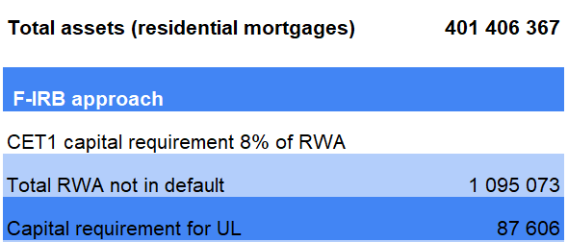
F-IRB approach – RWA for exposures not in default
RWA for unexpected loses are calculated using the risk-weight functions specified in Basel framework separately for defaulted and not-defaulted retail exposures.

Slide 11
F-IRB approach – RWA for exposures in default
According to CRE 31.3 The capital requirement (K) for a defaulted exposure is equal to the greater of zero and the difference between its LGD and the bank’s best estimate of expected loss (described in CRE36.86).The risk-weighted asset amount for the defaulted exposure is the product of K, 12.5, and the EAD.
In the Basel framework, the "bank's best estimate of expected loss" typically refers to the expected loss portion of the capital requirement. This estimate considers the potential losses the bank expects to incur on a credit exposure over a given period, incorporating factors such as the probability of default (PD), loss given default (LGD), and exposure at default (EAD).
The "bank's best estimate of expected loss" is not deducted from the LGD directly. Instead, it is compared to the LGD to determine the additional capital requirement (K) needed to cover any uncovered portion of the potential losses indicated by the LGD.

Slide 12
F-IRB approach – RWA for exposures in default
If the LGD is greater than the expected loss estimate, the difference (LGD - Expected Loss) represents the portion of the loss that is not covered by the bank's expected loss estimate. In this case, K would be greater than zero, indicating that additional capital is required to cover the uncovered portion of the loss.
If the expected loss estimate exceeds the LGD, meaning that the bank's estimate of expected loss is higher than the LGD, then K would be zero. In this scenario, the bank's estimate of expected loss fully covers the potential losses indicated by the LGD, and no additional capital is required beyond what is already accounted for in the expected loss estimate.
If the expected loss estimate is equal to LGD, then there is no uncovered portion of the potential losses indicated by the LGD. In this case, the bank's estimate of expected loss fully covers the potential losses, and there is no need for additional capital beyond what is already accounted for in the expected loss estimate.

Slide 13
F-IRB approach – RWA for exposures in default
For this calculation we assume that LGD is equal or lower to "bank's best estimate of expected loss".
The value of collateral for residential mortgages, taking under consideration raising real estate prices, is hardly expected to be lower than at the time of loan application.
Therefore, the K for defaulted loans in the portfolio would equal to 0, and as well RWA for defaulted loans will be 0, indicating that there is no uncovered portion of the potential losses that the bank should include in calculation of required capital.

Slide 14
F-IRB approach – Expected Losses
Calculated RWA under IRB approach produce capital requirements for unexpected losses (UL). Under IRB approach we need to calculate additionally Expected Loses.
For the project portfolio we assume that defaulted exposures should be considered as basis for expected losses calculation. For those exposures we calculate expected losses as:
EL = PD x EAD x LGD
Calculated expected losses for the portfolio = 100 279

Slide 15
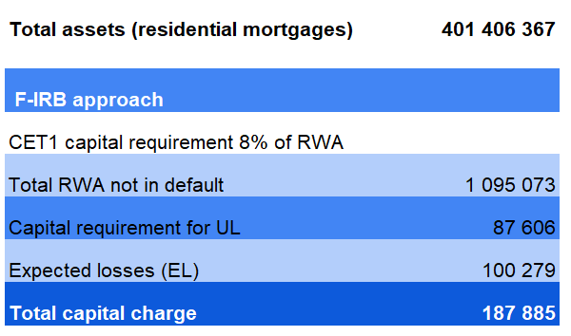
F-IRB approach – Total capital charge

Slide 16
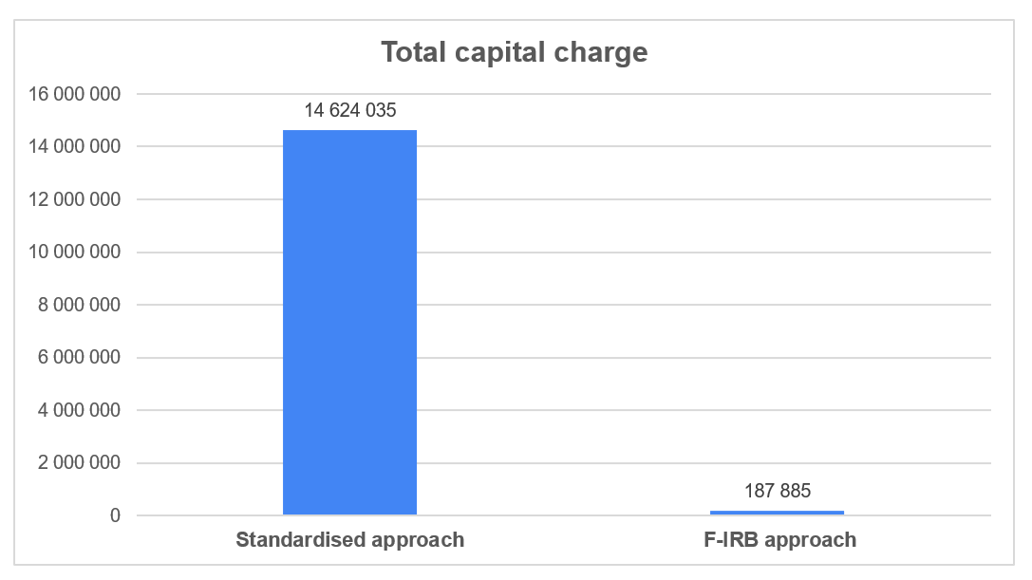
Total capital charge - comaparison

Slide 17
F-IRB approach – Internal definition of exposures in default
For risk-weighting purposes under the standardized approach, a defaulted exposure is defined as one that is past due for more than 90 days, or is an exposure to a defaulted borrower.
Under the IRB Approach, banks have greater flexibility in defining and identifying defaulted exposures based on their internal risk models and methodologies.
Banks develop their own criteria and thresholds for identifying defaulted exposures using a combination of quantitative indicators (e.g., delinquency status, credit scores) and qualitative factors (e.g., borrower's financial condition, likelihood of recovery).
The IRB Approach allows banks to tailor their definition of defaulted exposures to reflect their specific risk assessment frameworks and business practices, provided that their definitions are consistent with regulatory standards and adequately capture credit risk.
Banks must ensure that their assessments of defaulted loans comply with regulatory standards and guidelines.

Slide 18
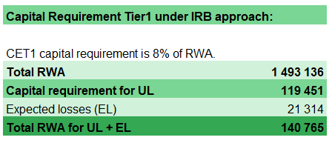
Internal definition of exposures in default – example scenario
In the previous calculation defaulted exposure were already defined, however under IRB approach the bank could develop own definition of defaulted loans, that could result in more capital savings. In this scenario we assume that defaulted exposures could be those with PD >= 0,9.
If we apply such scenario on the portfolio the calculations would be as follow:

Slide 19
Conclusions
In terms of capital charge for the portfolio, F-IRB approach is more beneficial for the bank, allowing for significant savings in comparison to Standardised approach.
Additionally, the bank could imply own definition of defaulted loans, that could result in even higher capital savings.

Slide 20
Advantages of the Standardized Approach
Simplicity: The Standardized Approach is straightforward and easy to implement compared to the IRB approaches. Banks can rely on predefined risk weights provided by regulators, reducing the complexity of risk measurement and regulatory compliance.
Consistency: Since risk weights are standardized across institutions, the Standardized Approach promotes consistency and comparability in regulatory capital requirements. This facilitates regulatory oversight and market transparency.
Lower Implementation Costs: Implementing the Standardized Approach typically requires fewer resources and less investment in data infrastructure, risk modelling, and validation compared to IRB approaches. This can lead to lower implementation costs for banks.

Slide 21
Disadvantages of the Standardized Approach
Lack of Risk Sensitivity: The Standardized Approach may not adequately reflect the risk profile of individual exposures or portfolios, as risk weights are based on broad asset classes rather than internal risk assessments. This could lead to misallocation of capital and inefficient risk management.
Less Customization: Banks have limited flexibility to tailor risk assessments to their specific risk profiles and business models under the Standardized Approach. This may result in suboptimal risk management strategies and pricing decisions.
Higher Capital Requirements: Standardized Approach may impose higher capital requirements compared to IRB approaches, particularly for low-risk exposures or portfolios where banks' internal assessments suggest lower credit risk.

Slide 22
Advantages of the Foundation IRB (F-IRB) Approach:
Risk Sensitivity: The F-IRB Approach allows banks to use their internal ratings to assess credit risk, resulting in more risk-sensitive capital requirements. This enables banks to better reflect the true risk profile of their loan portfolios and allocate capital more efficiently.
Customization: Banks have greater flexibility to tailor risk assessments to their specific risk profiles and business models under the F-IRB Approach. This allows for more granular risk measurement, better risk management, and more informed decision-making.
Potential for Lower Capital Requirements: The F-IRB Approach may result in lower capital requirements compared to the Standardized Approach for exposures where banks' internal assessments indicate lower credit risk. This can lead to cost savings and improved capital efficiency.

Slide 23
Disadvantages of the Foundation IRB (F-IRB) Approach:
Complexity: Implementing the F-IRB Approach requires significant investment in data infrastructure, risk modelling, and validation processes. The complexity of internal ratings models and regulatory compliance may pose challenges for smaller banks or those with limited resources.
Regulatory Oversight: Banks using the F-IRB Approach are subject to greater regulatory scrutiny and oversight compared to the Standardized Approach. Regulatory approval, ongoing validation, and compliance with regulatory standards are essential requirements for F-IRB implementation.
Data Requirements: The F-IRB Approach relies heavily on high-quality data, including historical loss data, borrower information, and economic indicators. Banks must have robust data management systems and processes in place to support accurate risk measurement and modelling.

Slide 24
Recommendations
If the bank decides on F-IRB Approach, the following steps would be highly recommended:
Improvement of PD model: training model(s) on larger dataset with quantitive and qualitive attributes connected with financial stability, debt payment capacity and willingness of a borrower, could improve estimation of default probabilities.
Calculation and implementation of „bank’s best estimation of expected loses” according to Basel Framework
Implementation of internal definition of defaulted exposures

Slide 25

Thank you

